Slide 1
Promolac
Location Based E-Marketing Services

Slide 2
Reaching Customers in the “Right Place” at the “Right Time” with the “Right Message” and “Experience”

Slide 3


Slide 4
Four Main Pillars of E-Marketing
GeoFencing
GeoTargeting
Geo Conquesting
Beacons Technology

Slide 5
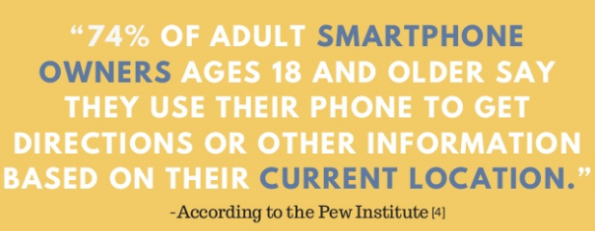

Slide 6
Features
Announcements in Targeted Areas
Location Updates Via Backend Services
Search for the best option in Auto Generated Categories
Create Push Notification for Targeted Audience
Offline Location Support

Slide 7
Architecture
Client Server Architecture
Repository Architecture

Slide 8
Why Repository Architecture?
Efficient way to share large amounts of data
Centralized Management that take control of backup, integrity and security
Integrate two databases Firebase and SQL Server
Maintain the workflow

Slide 9
Why Client-Server Architecture?
Organize the Client and server in set of layers each provide set of services
Data Encryption attain successfully
Message broadcast will be easy through server
Scalability

Slide 10
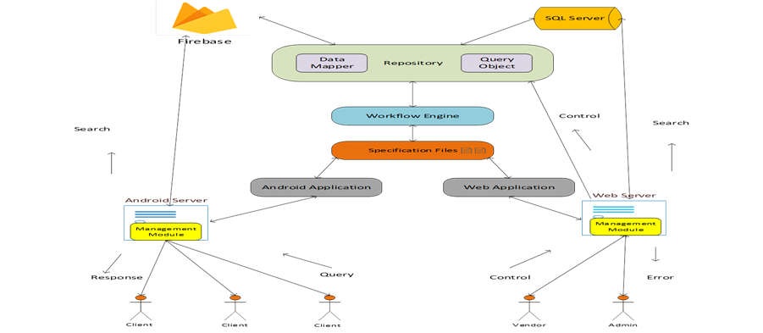

Slide 11
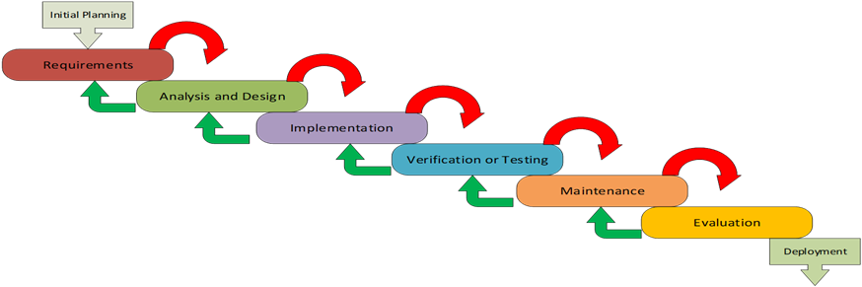
Iterative Model for Development

Slide 12
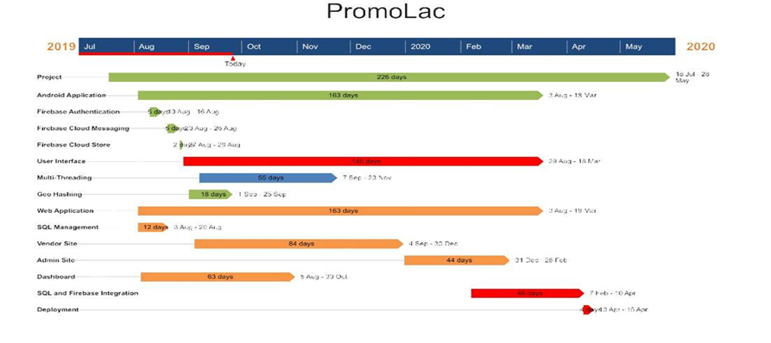
Gantt Chart

Slide 13


